Slide 1


Department of CSE
COMPUTER NETWORKS
24CS2202
Topic:
MAC PROTOCOLS: ALOHA
Session - 14

Slide 2



AIM OF THE SESSION
To familiarize students with the basic idea of ALOHA protocols
INSTRUCTIONAL OBJECTIVES
This Session is designed to:
Demonstrate the need for Random Access protocols
Describe the working of ALOHA protocols
LEARNING OUTCOMES
At the end of this session, you should be able to:
Illustrate the need for MAC protocols
Understand the working of Pure ALOHA protocol.
Understand the working of Slotted ALOHA protocol.

Slide 3
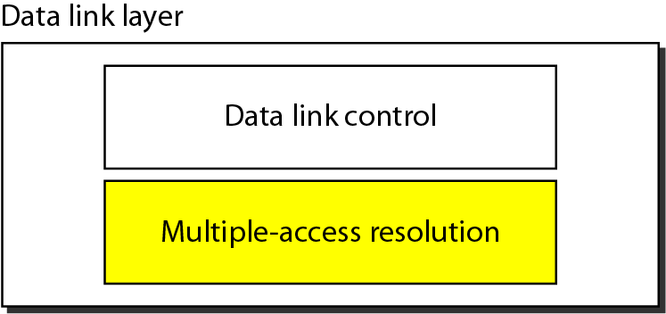
SESSION INTRODUCTION
Data link layer divided into two functionality-oriented sublayers.

Slide 4
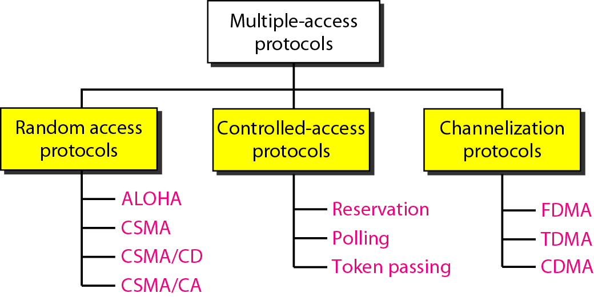
Random access protocols are mostly used in LANs and WANs.
Controlled-access protocols are used in LANs.
Channelization protocols are used in cellular telephony.

Slide 5
RANDOM ACCESS PROTOCOLS
In random access or contention methods, no station is superior to another station, and none is assigned the control over another.
No station permits, or does not permit, another station to send.
At each instance, a station that has data to send uses a procedure defined by the protocol to make a decision on whether or not to send.
ALOHA
Carrier Sense Multiple Access
Carrier Sense Multiple Access with Collision Detection
Carrier Sense Multiple Access with Collision Avoidance

Slide 6
RANDOM ACCESS PROTOCOLS…
In a random-access method, each station has the right to the medium without being controlled by any other station.
However, if more than one station tries to send, there is an access conflict—collision—and the frames will be either destroyed or modified.
To avoid access conflict or to resolve it when it happens, each station follows a procedure that answers the following questions:
    When can the station access the medium?
    What can the station do if the medium is busy?
    How can the station determine the success or failure of the transmission?
    What can the station do if there is an access conflict?

Slide 7
ALOHA PROTOCOLS
Pure ALOHA
Slotted ALOHA

Slide 8
PURE ALOHA PROTOCOL
The original ALOHA protocol is called pure ALOHA.
This is a simple but elegant protocol.
The idea is that each station sends a frame whenever it has a frame to send (multiple access).
However, since there is only one channel to share, there is the possibility of collision between frames from different stations.

Slide 9
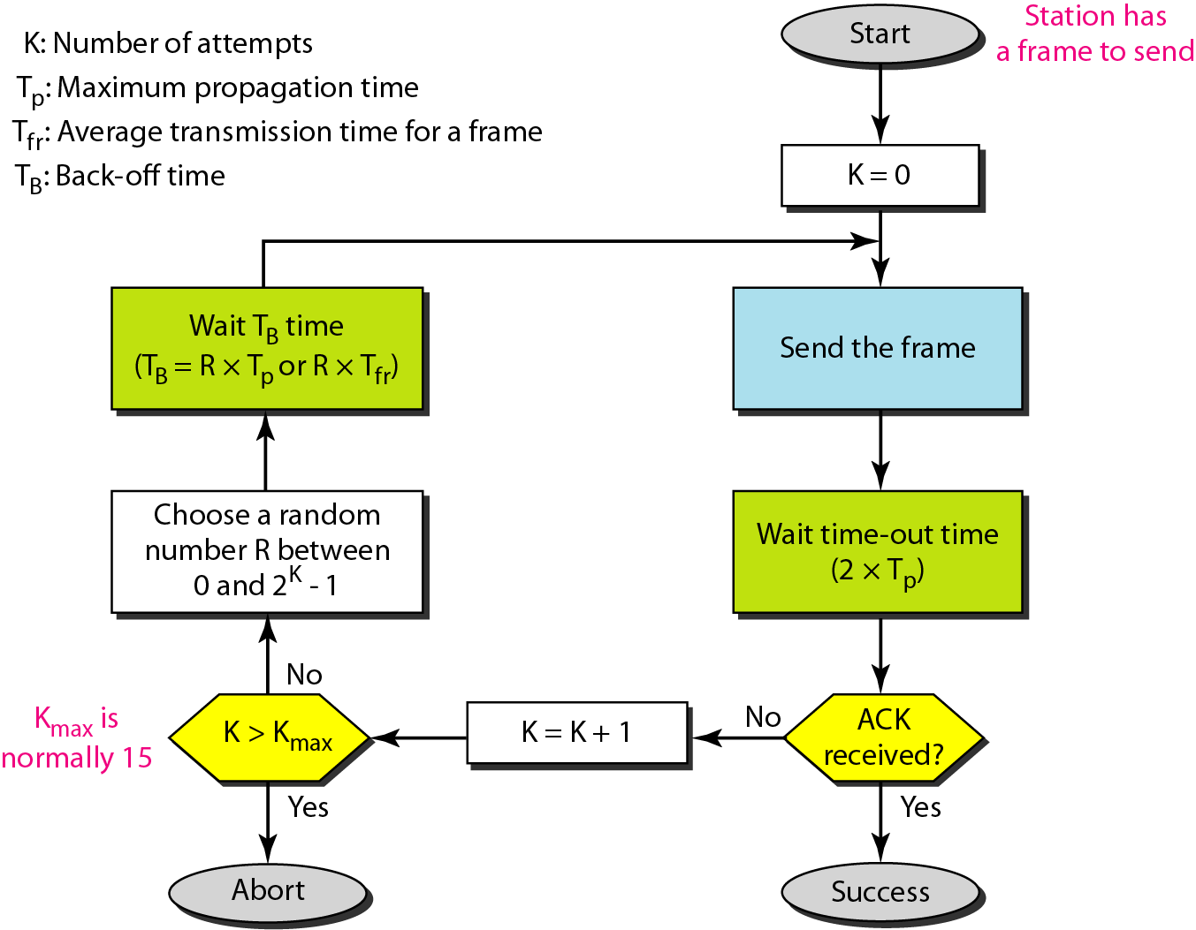
Procedure for pure ALOHA protocol

Slide 10
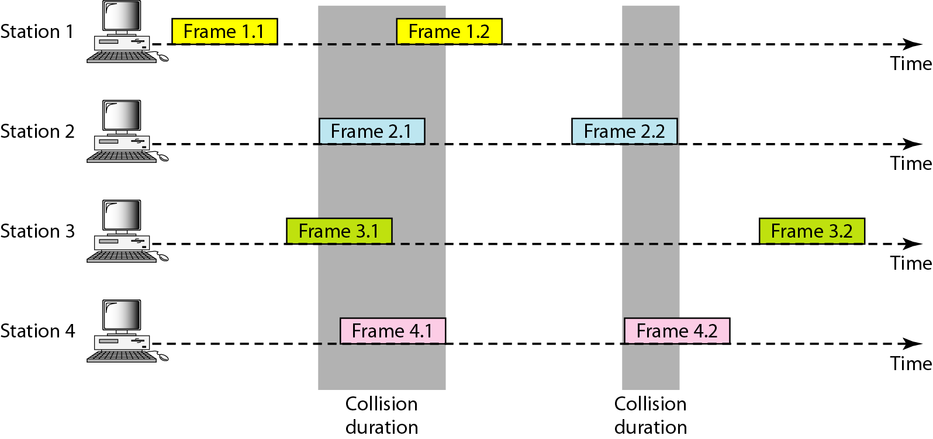
Frames transmission in a pure ALOHA network

Slide 11
Pure ALOHA…
There are four stations (unrealistic assumption) that contend with one another for access to the shared channel. Each station sends two frames; there are a total of eight frames on the shared medium.
Some of these frames collide because multiple frames are in contention for the shared channel. Figure 12.2 shows that only two frames survive: one frame from station 1 and one frame from station 3. We need to mention that even if one bit of a frame coexists on the channel with one bit from another frame, there is a collision, and both will be destroyed.
It is obvious that we need to resend the frames that have been destroyed during transmission.
The pure ALOHA protocol relies on acknowledgments from the receiver.
When a station sends a frame, it expects the receiver to send an acknowledgment. If the acknowledgment does not arrive after a time-out period, the station assumes that the frame (or the acknowledgment) has been destroyed and resends the frame.
A collision involves two or more stations. If all these stations try to resend their frames after the time-out, the frames will collide again.
Pure ALOHA dictates that when the time-out period passes, each station waits a random amount of time before resending its frame. The randomness will help avoid more collisions. We call this time the backoff time TB.

Slide 12
Pure ALOHA…
Pure ALOHA has a second method to prevent congesting the channel with retransmitted frames. After a maximum number of retransmission attempts Kmax, a station must give up and try later. The procedure is:
The time-out period is equal to the maximum possible round-trip propagation delay, which is twice the amount of time required to send a frame between the two most widely separated stations (2∗Tp).
The backoff time TB is a random value that normally depends on K (the number of attempted unsuccessful transmissions). The formula for TB depends on the implementation. One common formula is the binary exponential backoff. In this method, for each retransmission, a multiplier R = 0 to 2^K -1 is randomly chosen and multiplied by Tp (maximum propagation time) or Tfr (the average time required to send out a frame) to find TB.
Note that in this procedure, the range of the random numbers increases after each collision.
The value of Kmax is usually chosen as 15.

Slide 13
Example 1
The stations on a wireless ALOHA network are a maximum of 600 km apart. If we assume that signals propagate at 3 × 108 m/s, we find
Tp = (6 × 105 ) / (3 × 108 ) = 2 ms.
Now we can find the value of TB for different values of K .
For K = 1, the range is {0, 1}. The station needs to generate a random number with a value of 0 or 1. This means that TB is either 0 ms (0 × 2) or 2 ms (1 × 2), based on the outcome of the random variable.
For K = 2, the range is {0, 1, 2, 3}. This means that TB can be 0, 2, 4, or 6 ms, based on the outcome of the random variable.
For K = 3, the range is {0, 1, 2, 3, 4, 5, 6, 7}. This means that TB can be 0, 2, 4, . . . , 14 ms, based on the outcome of the random variable.
We need to mention that if K > 10, it is normally set to 10.

Slide 14
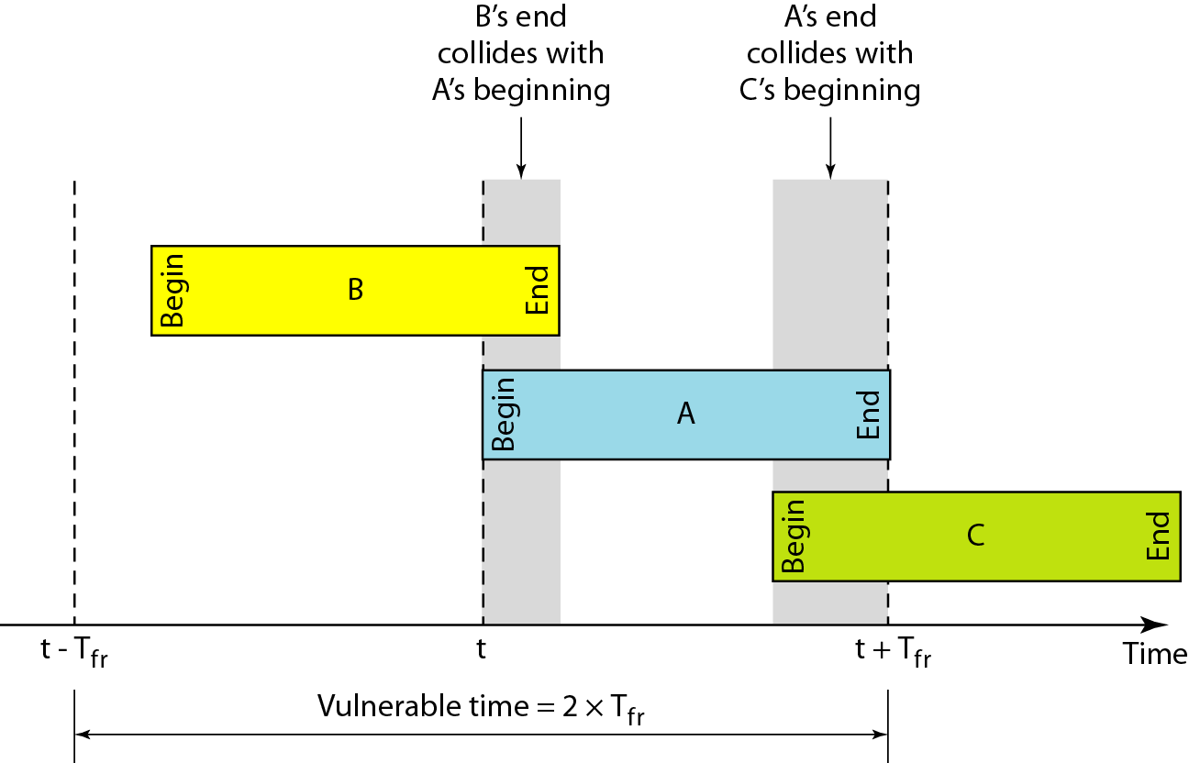

Vulnerable time for Pure ALOHA…
Vulnerable time: The length of time in which there is a possibility of collision.
Stations send fixed-length frames with each frame taking Tfr seconds to send. Figure shows the vulnerable time for station B.
Station B starts to send a frame at time t. Now imagine station A has started to send its frame after t -Tfr. This leads to a collision between the frames from station B and station A.
On the other hand, suppose that station C starts to send a frame before time t + Tfr. Here, there is also a collision between frames from station B and station C.
The vulnerable time during which a collision may occur in pure ALOHA is 2 times the frame transmission time.

Slide 15
Example 2
A pure ALOHA network transmits 200-bit frames on a shared channel of 200 kbps. What is the requirement to make this frame collision-free?
Solution
Average frame transmission time Tfr is 200 bits/200 kbps or 1ms.
The vulnerable time is 2 × 1 ms = 2 ms.
This means no station should send later than 1ms before this station starts transmission and no station should start sending during the one 1-ms period that this station is sending.

Slide 16

Throughput for Pure ALOHA…
G is the average number of frames generated by the system during one frame transmission time. Then it can be proven that the average number of successfully transmitted frames for pure ALOHA is S = G * e^-2G.
The maximum throughput Smax is 0.184, for G = 1/2.
In other words, if one-half a frame is generated during one frame transmission time (one frame during two frame transmission times), then 18.4 percent of these frames reach their destination successfully.
We expect G = 1/2 to produce the maximum throughput because the vulnerable time is 2 times the frame transmission time. Therefore, if a station generates only one frame in this vulnerable time (and no other stations generate a frame during this time), the frame will reach its destination successfully.

Slide 17
Example 3
A pure ALOHA network transmits 200-bit frames on a shared channel of 200 kbps. What is the throughput if the system (all stations together) produces
a. 1000 frames per second b. 500 frames per second c. 250 frames per second.
Solution
The frame transmission time is 200/200 kbps or 1 ms.
a. If the system creates 1000 frames per second, this is 1 frame per millisecond. The load is 1. In this case
S = G× e−2 G or S = 0.135 (13.5 percent). This means that the throughput is 1000 × 0.135 = 135 frames.
Only 135 frames out of 1000 will probably survive.
b. If the system creates 500 frames per second, this is (1/2) frame per millisecond. The load is (1/2). In this case S = G × e −2G or S = 0.184 (18.4 percent). This means that the throughput is 500 × 0.184 = 92 and that only 92 frames out of 500 will probably survive.
c. If the system creates 250 frames per second, this is (1/4) frame per millisecond. The load is (1/4). In this case S = G × e −2G or S = 0.152 (15.2 percent). This means that the throughput is 250 × 0.152 = 38. Only 38 frames out of 250 will probably survive.

Slide 18
SLOTTED ALOHA PROTOCOL
Pure ALOHA has a vulnerable time of 2*Tfr. This is so because there is no rule that defines when the station can send. A station may send soon after another station has started or just before another station has finished.
Slotted ALOHA was invented to improve the efficiency of pure ALOHA.
In slotted ALOHA we divide the time into slots of Tfr seconds and force the station to send only at the beginning of the time slot.
Because a station is allowed to send only at the beginning of the synchronized time slot, if a station misses this moment, it must wait until the beginning of the next time slot.
This means that the station which started at the beginning of this slot has already finished sending its frame.

Slide 19
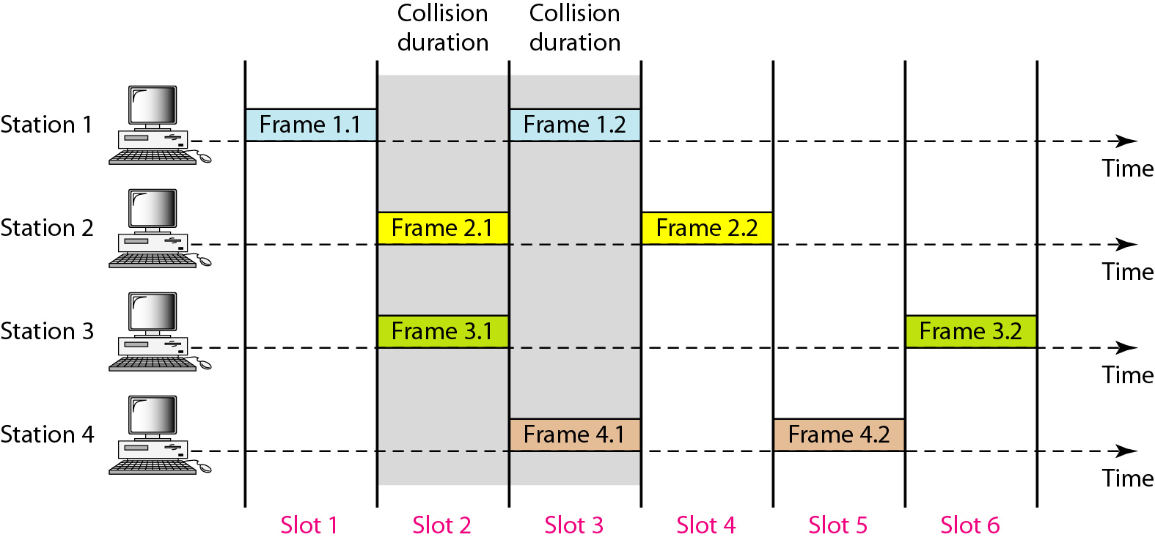
Figure 12.6 Frames in a slotted ALOHA network

Slide 20
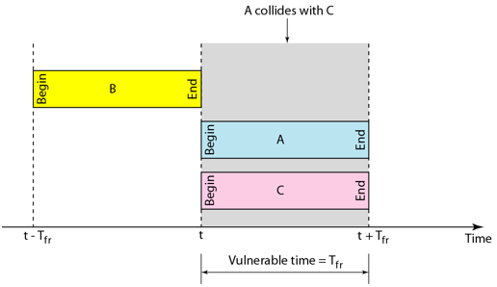

Vulnerable time for Slotted ALOHA
Of course, there is still the possibility of collision if two stations try to send at the beginning of the same time slot.
However, the vulnerable time is now reduced to one-half, equal to Tfr.

Slide 21

Throughput for Slotted ALOHA…
It can be proven that the average number of successful transmissions for slotted ALOHA is S = G ∗e^-G.
The maximum throughput Smax is 0.368, when G = 1. In other words, if one frame is generated during one frame transmission time, then 36.8 percent of these frames reach their destination successfully.
We expect G = 1 to produce maximum throughput because the vulnerable time is equal to the frame transmission time.
Therefore, if a station generates only one frame in this vulnerable time (and no other station generates a frame during this time), the frame will reach its destination successfully.

Slide 22
Example 4
A slotted ALOHA network transmits 200-bit frames on a shared channel of 200 kbps. What is the throughput if the system (all stations together) produces
a. 1000 frames per second b. 500 frames per second c. 250 frames per second.
Solution
The frame transmission time is 200/200 kbps or 1 ms.
If the system creates 1000 frames per second, this is 1 frame per millisecond. The load is 1. In this case S = G× e−G or S = 0.368 (36.8 percent). This means that the throughput is 1000 × 0.0368 = 368frames.
Only 386 frames out of 1000 will probably survive.
If the system creates 500 frames per second, this is (1/2) frame per millisecond. The load is (1/2). In this case S = G × e−G or S = 0.303 (30.3 percent). This means that the throughput is 500 × 0.0303 = 151. Only 151 frames out of 500 will probably survive.
If the system creates 250 frames per second, this is (1/4) frame per millisecond. The load is (1/4). In this case S = G × e −G or S = 0.195 (19.5 percent). This means that the throughput is 250 × 0.195 = 49. Only 49 frames out of 250 will probably survive.

Slide 23

SUMMARY
Random Access Protocols
ALOHA Protocols
  Pure ALOHA
  Slotted ALOHA

Slide 24
TERMINAL QUESTIONS
1. Describe the working of Pure ALOHA protocol.
2. Describe the working of Slotted ALOHA protocol.

Slide 25
REFERENCES FOR FURTHER LEARNING OF THE SESSION
Reference Books:
Behrouz A. Forouzan , “Data Communication and Networking”, TMH, 5th Edition, 2012.
A.S. Tanenbaum, David J. Wetheral “Computer Networks” Pearson, 5th Edition.

Slide 26
THANK YOU
Team – Computer Networks

